Slide 1
Sure-Park: Parking lot management system
2016/6/24
5 (Oh!) Team

Slide 2
Contents
Overview
Analysis
Architecture drivers
Design
Dynamic perspective
Static perspective
Physical perspective
Test
Project Management
Plans, Time log
Risk
Lessons learned

Slide 3
1. Overview
The project sponsors is Geoff’s Transportation and Parking Services (GPTS LLC).
GPTS LLC own several parking garages and lots, have concerns about inefficiencies in their parking garages and lots.
We have to enable drivers to easily find a parking facility with available parking slots and reserve them.

Slide 4
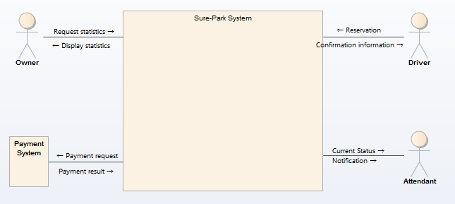



1. Overview
System context diagram
Actors
External System

Slide 5
2. Analysis
Architecture drivers
Functional requirements
3. Park a car
1. Manage
2. Reserve a slot

Slide 6
2. Analysis
Architecture drivers
Quality attributes with “High” priority
ID | UC # | Ability | Description
QA-04 | UC 1.2 | Performance | When the system should deliver a notification to the attendant, it must be delivered within 3 seconds.
QA-07 | UC 1.5 | Security | The system should be able to restrict access to each function of the account authority.
QA-10 | UC 2.1 | Performance | The system shall provide confirmation information within 3 seconds on parking reservation complete.
QA-11 | UC 3.1 | Reliability | System shall be able to detect arrival of driver 99% at entry/exit gate of parking lot.
QA-14 | - | Availability | The parking system shall be available for 24 * 7 * 365 without stop.

Slide 7
2. Analysis
Architecture drivers
Constraints - Business
ID | Type | Description
CST-01 | Business | The system should more efficiently utilize personnel and reduce the number of people required to operate any given garage reducing operating costs.
CST-02 | Business | The system should reduce traffic congestion and the chance for accidents inside the parking facilities reducing liabilities.
CST-03 | Business | The system should be scalable to N facilities.
CST-04 | Business | The system should reduce driver frustration and enable them to easily find a parking facility with available parking slots and reserve them.
CST-05 | Business | The system should more efficiently utilize the space in their parking facilities thereby increasing profits.
CST-06 | Business | The parking lot system only accept a driver with reservation.
CST-07 | Business | The parking lot system only accept a credit card for payment.

Slide 8
2. Analysis
Architecture drivers
Constraints - Technical
ID | Type | Description
CST-08 | Technical | The system need network for reservation, payment and management.
CST-09 | Technical | The system need some data storing mechanism for store data (reservation, payment, revenue and so on)
CST-10 | Technical | The system cannot change the type of controller, sensors, or actuators (e g. gate lift servo), although use multiple controllers to accommodate a larger facility.
CST-11 | Technical | The system must check with the owner before using open software.
CST-12 | Technical | The system should not store driver's payment information as it is.

Slide 9
3. Design
Dynamic perspective
Why?

Slide 10
3. Design
Dynamic perspective
Why?

Slide 11
3. Risks
We identified several risks
ID | Impact | Probability | Risk
RID-01 | 4 | 2 | No experience on developing with Arduino
RID-02 | 3 | 2 | No experience on developing with server-client system
RID-03 | 5 | 5 | Too short time for project
RID-04 | 4 | 4 | Requirement change occurred by customer
RID-05 | 3 | 3 | Difficulty on scale up of parking lots
* Impact defines between 1 (minimal) to 5 (catastrophe)
* Probability defines between 1 (unlikely) to 5 (likely)

Slide 12
3. Risks
We are ready to mitigate identified risks.
ID | Risk | Mitigation plan | Expectation
RID-03 | Too short time for project | - We will work at weekend to make more time to work. - We will make centralized design to manage system complexity in one place. - We will choose an experienced way to develop UI applications | Probability will goes down 5 → 3 or 2 at 6/1
RID-04 | Requirement change occurred by customer | - We will ask customer every day whether requirements are changed or not. - We will make a strong design for requirement change. | Probability will goes down 4 → 2 at 6/5

Slide 13
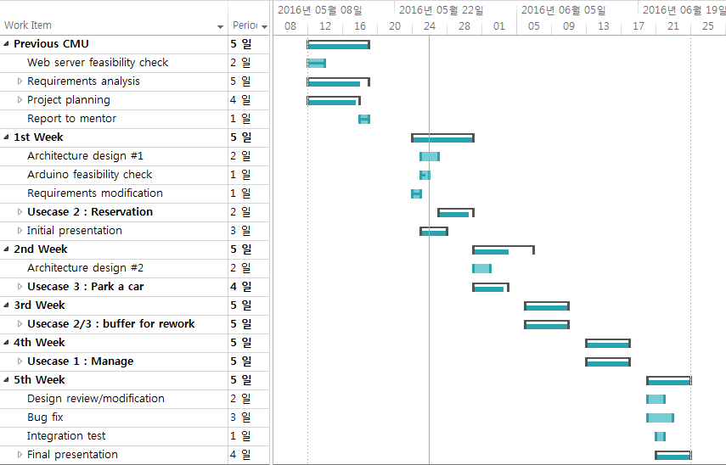
4. Project plans
We made a strong iterative plans to achieve goal
1 week for 1 usecase group
Test is also completed in each week
1 week for buffer to mitigate risks

Slide 14
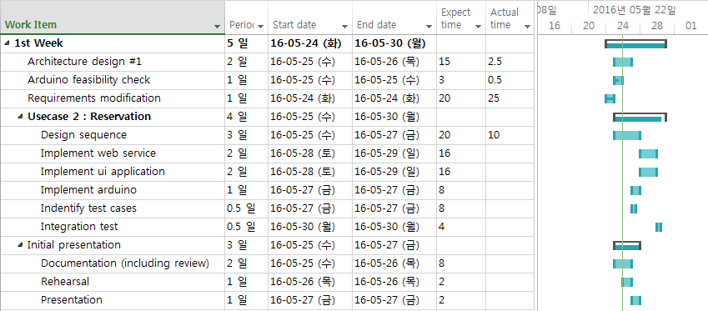
4. Project plans
Detailed plans for first week
Plan is changed due to test and reading assignment for 1st week

Slide 15
4. Project plans
Roles and Responsibility
Role | Primary owner | Secondary owner | Remarks
Project Manager | Jaedo Jin | Sanghee Lee | -
Architect | Sanghee Lee | All | -
Requirement Manager | Kimoon Lee | Sanghee Lee | -
Test Manager | Daedon Jeon | Sanghee Lee | -
Web-server developer | Yongchul Park | Jaedo Jin | -
UI App developer | Kimoon Lee | Jaedo Jin | Andriod App Experts
Embedded system developer | Daedon Jeon | - | Embedded system expert
Configuration manager | Yongchul Park | Sanghee Lee | -
Database manager | Sanghee Lee | Yongchul Park | -

Slide 16
4. Project plans
Time logs

Slide 17
Appendix. Usecase diagram
Level 1

Slide 18
Appendix. Usecase scenario example
3.1 Parking
Use Case Title : Parking | Use Case ID : UC 3.1
General use case description: This use case describe how to park a car in parking lot
Entities involved: Driver, Attendant
Preconditions: The driver arrives parking lot within grace period of reservation.
Primary use case flow of events:
1. System recognize arrival of driver.
2. System request to enter the confirmation information.
3. Driver enters confirmation information.
4. System verify confirmation information.
5. System display park space identifier.
6. System open the entry gate.
7. System turn a green right on to show where to park.
8. Driver park at assigned parking lot.
9. System recognize parking successfully ….
Primary use case post-conditions: Driver park a car in assigned parking lot.
Alternate use case #4-A, #8-A
4-A.1 If driver's confirmation information is not valid, system call nearest attendant.
8-A.1 If driver do not park a car at assigned parking lot, system recognize this problem.
8-A.2 System reallocate problem-making car's assigned parking lot to its parked place.

Slide 19
Appendix. QA scenario example
3.1 Parking
ID | QA-11 (Performance)
Source of stimulus | Driver
Stimulus | Driver arrives at the entry gate (entry IR detector).
Artifacts | Arduino system
Environment | Driver is detected by entry IR detector.
Response | Arrival of driver
Response measure | The system requires 99% rate of success as a detection of arrival.

